Slide 1
Interactive Marketing (Trading) Game
Great Ideas for Teaching Marketing
Geoff Fripp: Marketing Educator and Author

Slide 2




There are two sets of channel players in this game
Manufacturers of shoes
Retailers of shoes

Slide 3
About Manufacturers
The manufacturers can produce any of the three shoes product lines:
L1 = low quality
L2 = medium quality
L3 = high quality
The manufacturers get to choose their product line EACH round and how much of each line they will produce
Within their budget

Slide 4
About Retailers
Retailers have FIXED positioning for the game
You will be either:
High-end specialty store
General specialty store
Discount retailer

Slide 5
What Product Lines these Retailers Buy
Retailers buy product lines that support their positioning
High-end specialty stores = L2 and L3 quality shoes (mid=high)
General specialty stores = All three levels (L1, L2, and L3)
Discount retailers = L1 and L2 quality shoes (low-mid)

Slide 6
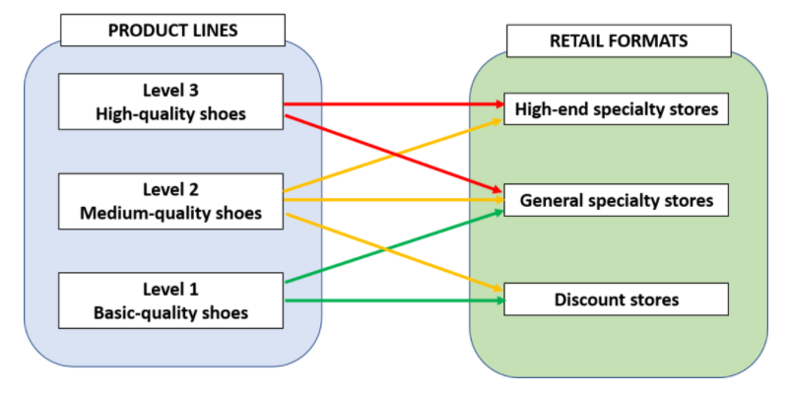
Retailers: Remember what product lines you buy and sell
Manufacturers: Know who your customers are for each product line you produce

Slide 7
Number of Teams
Here are 9 teams
3 manufacturers
and 6 retailers
We always need
retailers in sets of 3
So we can have:
3 M’s and 6 R’s
4-5 M’s and 6 R’s
6+ M’s and 9 R’s

Slide 8
You Will Have Access to a Planning Spreadsheet
Let’s Work Through It…

Slide 9
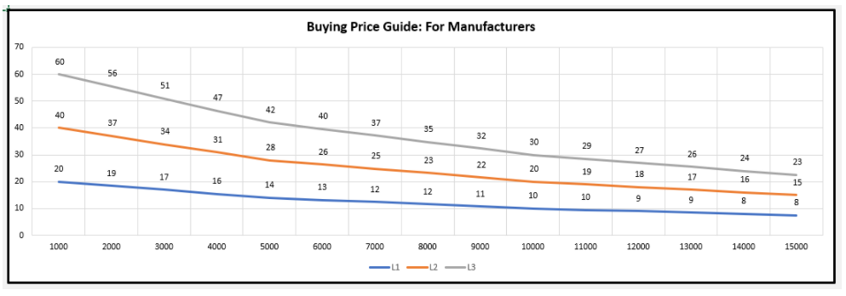
For Manufacturers
The more you produce, the lower your unit cost
Example: L2 – if you produce 1,000 units = unit cost = $40 BUT… if your product 5,000 units = unit cost = $28
This chart is in the spreadsheet

Slide 10
For Manufacturers
Here is your planning sheet

Slide 11
For Manufacturers
Here is your planning sheet
Enter in the BLUE cells only

Slide 12
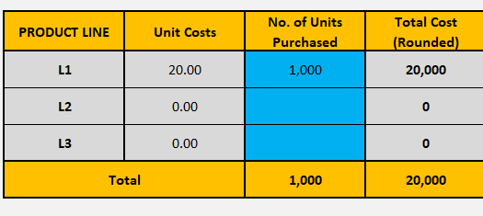
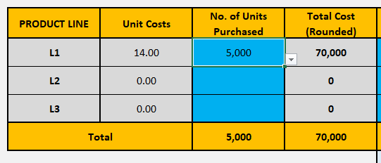
It will AUTO calculate for you

Slide 13
And your forecast is provided
You plan what and how much to produce
Within your budget
How much you would like to sell for
How many units you would like to sell

Slide 14
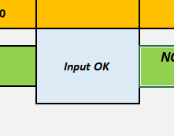
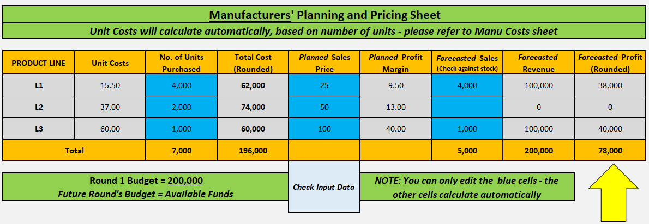
Check for… Input OK
What is wrong here???

Slide 15
For Retailers
Here is your planning sheet
It will AUTO calculate for you – enter in the BLUE cells
Remember which product lines that buy/sell - if you are a discounter (L1/L2) or high end speciality store (L2/L3)

Slide 16
For Retailers – Discounter Example
Here is how to use your planning sheet
You plan how much you want to pay per line
And how many of each
Within your budget
How much you would like to sell for
How many you would like to sell
And your forecast is here

Slide 17
You will interact with the relevant channel players to trade between you.
You strike deals on PRICE and QUANTITY
This means that you may NOT get your target price or sales volume
Because you are competing in an open marketplace
IMPORTANT
The price that manufacturers get and retailers pay is reached by your deals and negotiation

Slide 18
How Much Do Retailers Sell For?
L1 products are reasonably price elastic and can have a final retail price of $50 to $100 only
L2 products are somewhat price elastic and can have a final retail price of $100 to $150 only
L3 products are generally price inelastic and can have a final retail price of $150 to $200 only

Slide 19
Can we just choose the maximum?
L1 products are reasonably price elastic and can have a final retail price of $50 to $100 only
L2 products are somewhat price elastic and can have a final retail price of $100 to $150 only
L3 products are generally price inelastic and can have a final retail price of $150 to $200 only
Yes, BUT…
You are competing against other retailers
Which the spreadsheet takes into account

Slide 20
This shows A/B vs C/D vs E/F retailers competing
One prices at the minimum and one at the max
So you can see the impact on sales and profits
Note: Max. retail sales per product line per round

Slide 21
